Slide 1

Nest.js
By Aleksandr Podyachev

Slide 2

What is NesTjs?
Nestjs is a web framework in TypeScript and run on Nodejs
It allows you to create web apps and Rest APIs in TypeScript out of the box
It uses Express behind the scenes, but you can set it up to use Fastify instead

Slide 3
How to install nestjs?
Install Nodejs
Run npm i -g @nestjs/cli

Slide 4
Nest Cli
New: creates a new nestjs projects
Generate: creates/modifies a file
Build: Compiles the project to the target folder
Start: compiles and starts the project
Add: imports a nestjs library to the project
Info: lists information about nestjs library and system info

Slide 5

Project Structure
App.controller.ts: Basic controller with a single route
App.controller.spec.ts: Unit tests for controller
App.module.ts: Root module for the application
App.service.ts: Main service of the application
Main.ts: Main file of the application

Slide 6
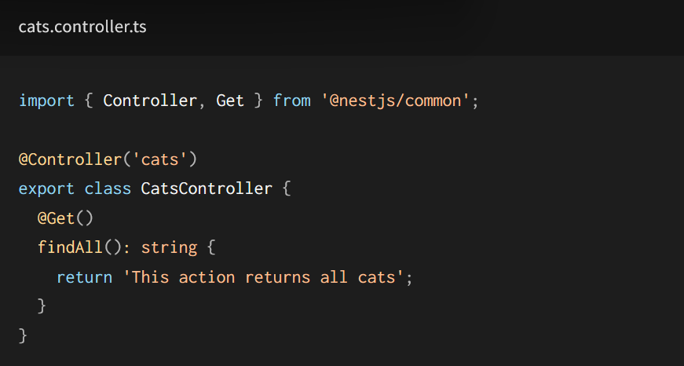
Hello World / Get Request

Slide 7

Controllers
Respond to HTTP requests
Uses decorators on functions to handle HTTP requests

Slide 8

Services
Services allow you to access data, from any data source that you set up

Slide 9

Modules
Modules are a way to conveniently package controllers and services

Slide 10
Decorators
Get, Post, Put, Delete: specify endpoint handlers
Body: casts the request body to a handler method parameter
Param: casts a URL path value to a handler method parameter
Query: casts a query value to a handler method parameter

Slide 11

Other Features
Middleware
Exception Filters
Guards

Slide 12

Can be used to make
GraphQL server
Microservies

Slide 13






Companies that Use Nestjs

Slide 14

Questions/Demo

